Slide 1



Slide 2

Designing of Light/Fan Automation System Based on Arduino Bluetooth Interface using Android Smartphone
Presenting on

Slide 3
Presenting To: -
Monir Hossain
Lecturer, Dept. of CSE,
CCN University of Science & Technology
Presenting By: -
Group Number: 02
Group Members
Tanim Hasan
111001010
Moien Uddin
111001002
Abdur Rob Shamim
111001019
Auntar Chandra Das
111120003

Slide 4
Outlines
Abstract
Introduction
Project Implementation Procedure
Performance Evaluation
Cost Analysis
Pros & Cons of the Project
Application of the project
Conclusion

Slide 5
Abstract
We are living in 21 centuries where all the things are smart and plays an important role in human life. The concept is applied to large machines or robots which help in increasing the efficiency in terms of production, energy, and time. The main objective of this project is to develop a smartphone control automation system using an Arduino board with Bluetooth being remotely controlled by any Android OS smart phone. As technology is advancing so houses are also getting smarter. Modern houses are gradually shifting from conventional switches to centralized control system, involving remote controlled switches. Presently, conventional wall switches located in different parts of the house makes it difficult for the user to go near them to operate. Even more it becomes more difficult for the elderly or physically handicapped people to do so. Smart controlled automation system provides a most modern solution with smart phones. To achieve this, a Bluetooth module is interfaced to the Arduino board at the receiver end while on the transmitter end, a GUI application on the cell phone sends ON/OFF commands to the receiver where loads are connected. By touching the specified location on the GUI, the loads can be turned ON/OFF remotely through this technology.

Slide 6
Introduction
1.1 Project Aim:
The aim of the project is to design and construct a home automation system that will remotely switch on/off any household appliances connected to it, using a microcontroller, Bluetooth based android application.
1.2 Project Objective
The objective of this project is to implement a low cost, reliable and scalable home automation system that can be used to remotely switch on/off any household appliance, using a microcontroller to achieve hardware simplicity, low cost.

Slide 7
1.3 Project scope and limitation:
This project work is complete on its own in remotely and automatically switching on/off an electrical appliance not limited to household appliances and sends a feedback message indicating the new present state of the appliance.
1.4 Description of the Project:
This project is one of the important Arduino Projects. Arduino based home automation using Bluetooth project helps the user to control any electronic device using Device Control app on their Android Smartphone. The android app sends commands to the controller Arduino, through wireless communication, namely, Bluetooth. When the user presses on the 'On' button displayed on the app for the device the light is switched on. This light can be switched off, by pressing the same button again. Similarly, when the user presses on the "On" button displayed on the app for the device 2, the fan is switched on. The fan can be switched off, by pressing the same button again. This project of home automation using Bluetooth and Arduino can be used for controlling any AC or DC devices.

Slide 8
Project Implementation Procedure
Required Equipment
Hardware
Arduino Uno R3
HC-05 Bluetooth Module
Male Female Jumper Wire
220V 80W Hot Melt Glue Gun
5V 2-Channel Relay Module
Bulb Lamp
220V AC Line
Adapter
Software Arduino IDE Arduino Drive Software Proteus ISIS Device PC Windows 11

Slide 9
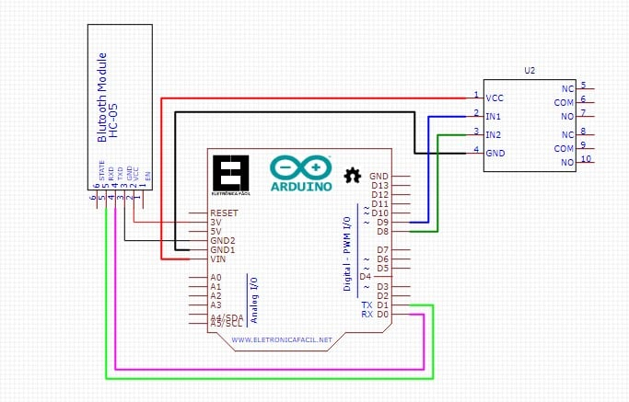
Procedure
Circuit connection
All the connection of the system was completed like this circuit diagram.

Slide 10
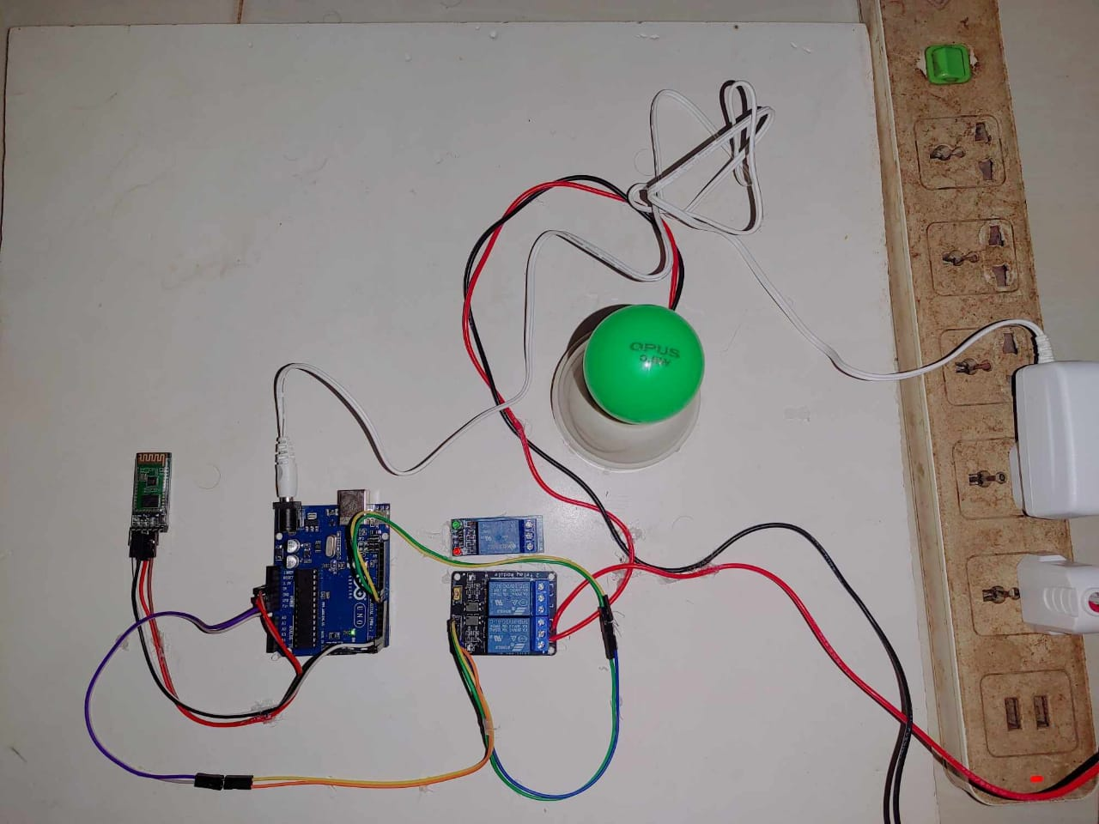
After completing the setup, the circuit-

Slide 11
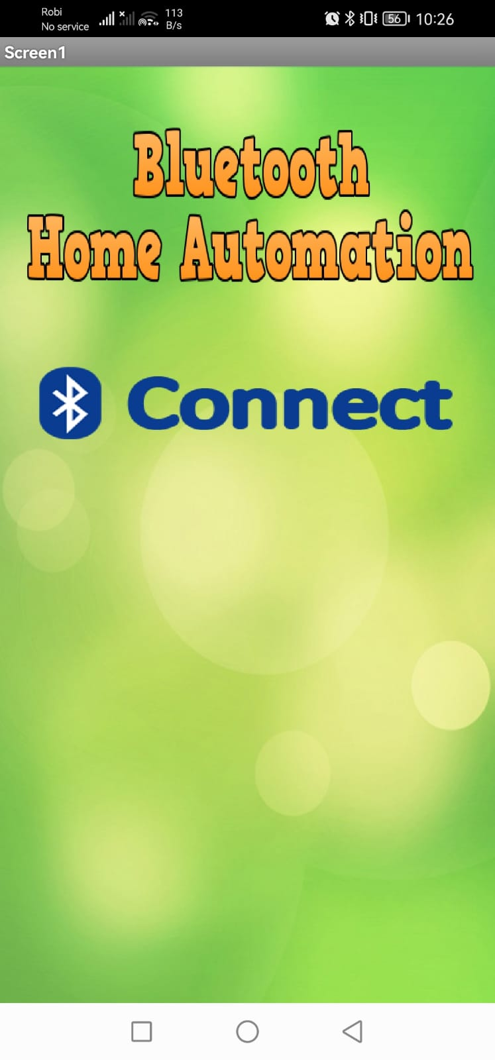
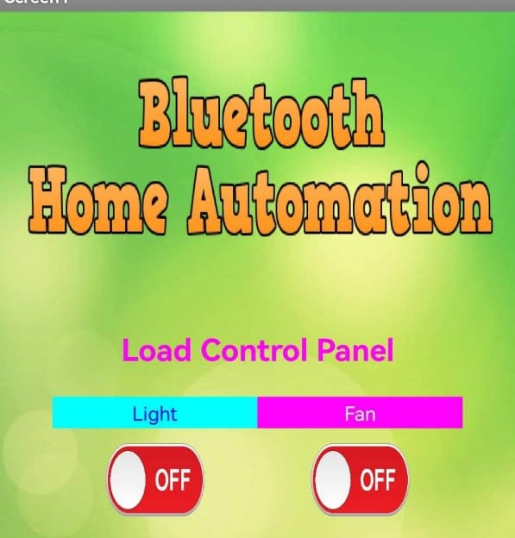
Downloading the android application and setting up Bluetooth

Slide 12
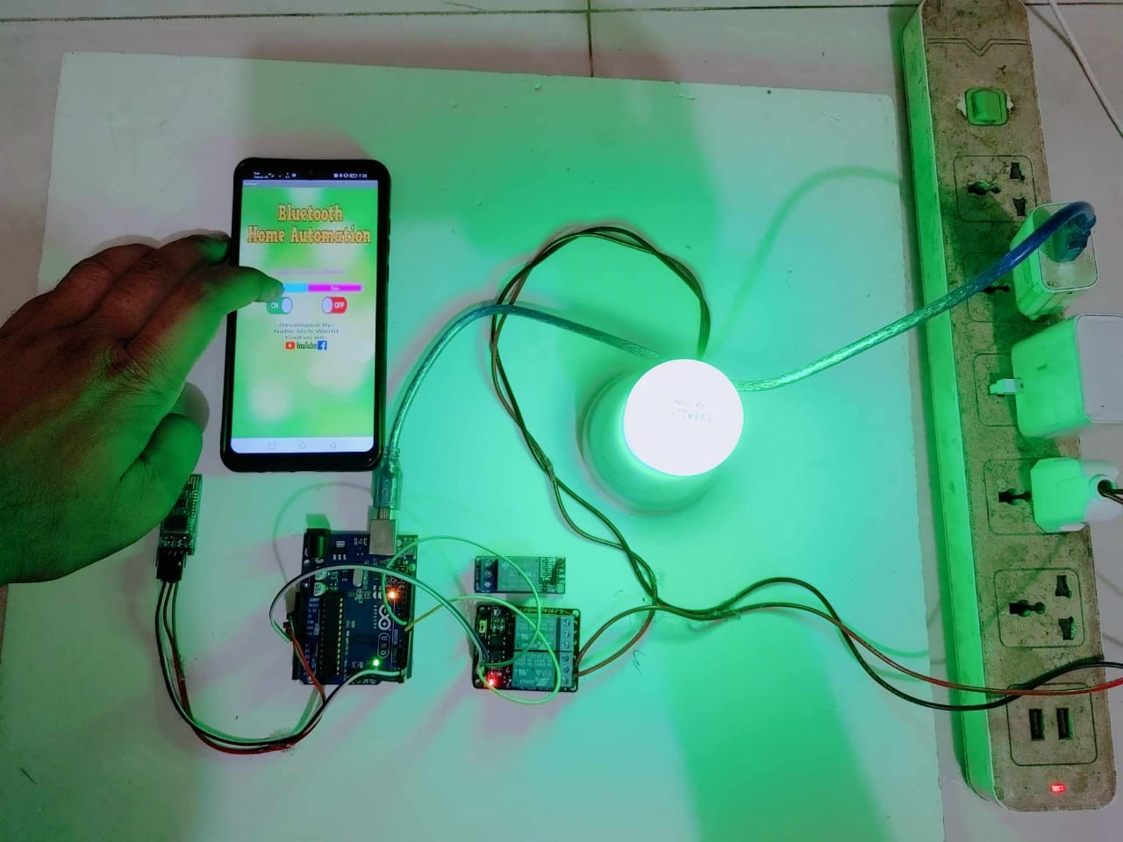
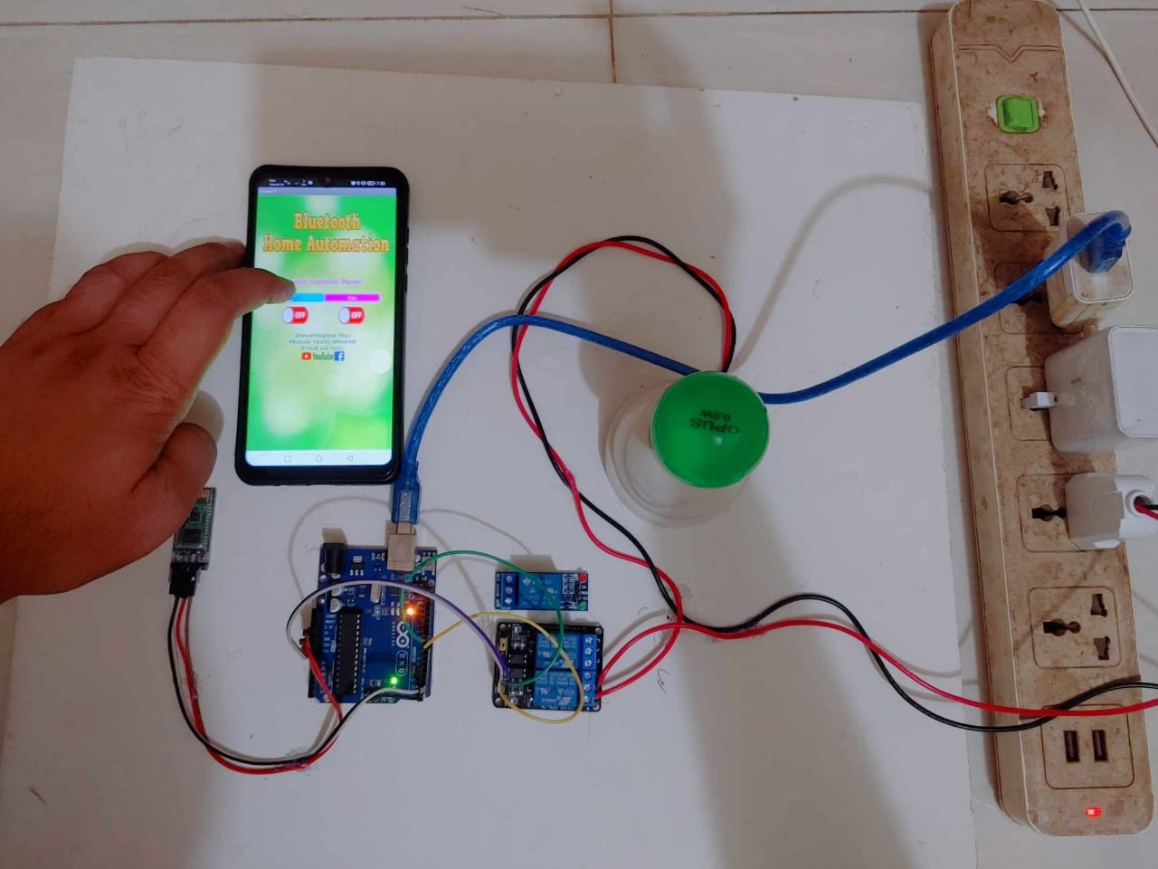
Performance Evaluation
We have implemented a system that we designed. Some response we are getting.

Slide 13
Cost Analysis
Here we used these products to design the project and the total cost is approximately 1870/-. We got these products by ordering from online that’s why they need some extra cost, but while we buy something from wholesale market of course the cost will reduce. For every household electronic device, we need extra relay to control them. As we implemented first time, some products need to be bought as an asset equipment and it has increased our total cost also.
Item | Unit | Price | Cost
5V 1A Power Adapter (High Quality) | 1 | 180 | 180
Arduino Uno R3 | 1 | 790 | 790
5V 1 Channel Relay Module | 3 | 90 | 270
HC 05 Bluetooth Module | 1 | 330 | 330
Male To Female Jumper Wire | 1 | 80 | 80
220V 80W Hot Melt Gun | 1 | 220 | 220
Total Cost | - | - | 1870

Slide 14
Pros of the Project
Security
Convenience
Energy Efficiency
Safety
Savings
Smart & Secure Home
Peace of Mind

Slide 15
Cons of the project
Installation Cost
Lack of Flexibility
Limited Creativity
Maintenance and Repairs

Slide 16
Applications of this project
1. Using this project, we can turn on or off appliances remotely i.e., using a phone or tablet.
2. The project can be further expanded to a smart home automation system by including some sensors like light sensors, temperature sensors, safety sensors etc. and automatically adjust different parameters like room lighting, air conditioning (room temperature), door locks etc. and transmit the information to our phone.
3. Arduino based device control using Bluetooth on Smartphone project can be enhanced to control the speed of the fan etc.

Slide 17
Conclusion
The home automation system has been experimentally proven to work satisfactorily by connecting sample appliances to it and the appliances were successfully controlled from a wireless mobile device. We learned many skills such as soldering, wiring the circuit and other tools that we use for this project and was able to work together as a team during this project. The Bluetooth client was successfully tested on a multitude of different mobile phones from different manufacturers, thus proving its portability and wide compatibility. Thus, a low-cost home automation system was successfully designed, implemented, and tested.

Slide 18


